Slide 1
Food Consumption in the US
Renee Hosogi
GA Data Science
January 22, 2015

Slide 2
World population projected to reach 9.6 billion by 2050
New projected population is higher, mainly due to new information obtained on fertility levels of certain countries
Developed regions will remain largely unchanged at until 2050, 49 least developed countries are projected to be 1.8 billion in 2050.
Based on 233 countries’ censuses from 2010.

Slide 3
That’s a lot of people… In theory

Slide 4
As data scientists, we know that these numbers aren’t always right but does the rest of the world know?

Slide 5
In 2014, 83% of Americans identified as being environmentally conscious.
In 2013, 90% of Americans believed that they were healthy.

Slide 6
Are American consumers purchasing healthily and sustainably through actual expenditure?

Slide 7
Let’s use food to see!
My two factors: meat and produce
Meat production requires a lot of water:
About 460 gallons for 1/4 pound of beef*
About 500 gallons/pound of chicken*
Produce on the other hand, requires less:
About 39 gallons/pound of oranges
About 110 gallons/pound of corn
Meat is often referred to as an unsustainable food source, but there are increasingly more sustainable sources.
*Includes water for feed and grazing land

Slide 8
Red meat consumption in particular has also been sited over several years to promote cardiovascular disease, high blood pressure, and certain cancers
Most recently, the World Health Organization stated that over-consumption of cured meats would cause cancer over time…
Doesn’t make it any less delicious!

Slide 9
Let’s see…
Consumer Expenditure reports from the Bureau of Labor Statistics from 2010-2014
Fmld files
4 per year
Focuses on smaller purchases
538 columns by 3,000-5,000 rows per file
Focused on meat and produce consumption

Slide 10
Compiling the fmld files
$ cat < fmld141.csv <(tail +3 fmld142.csv) <(tail +3 fmld143.csv) <(tail +3 fmld144.csv) > veg14.csv
Rinse and repeat for 2010-2013

Slide 11
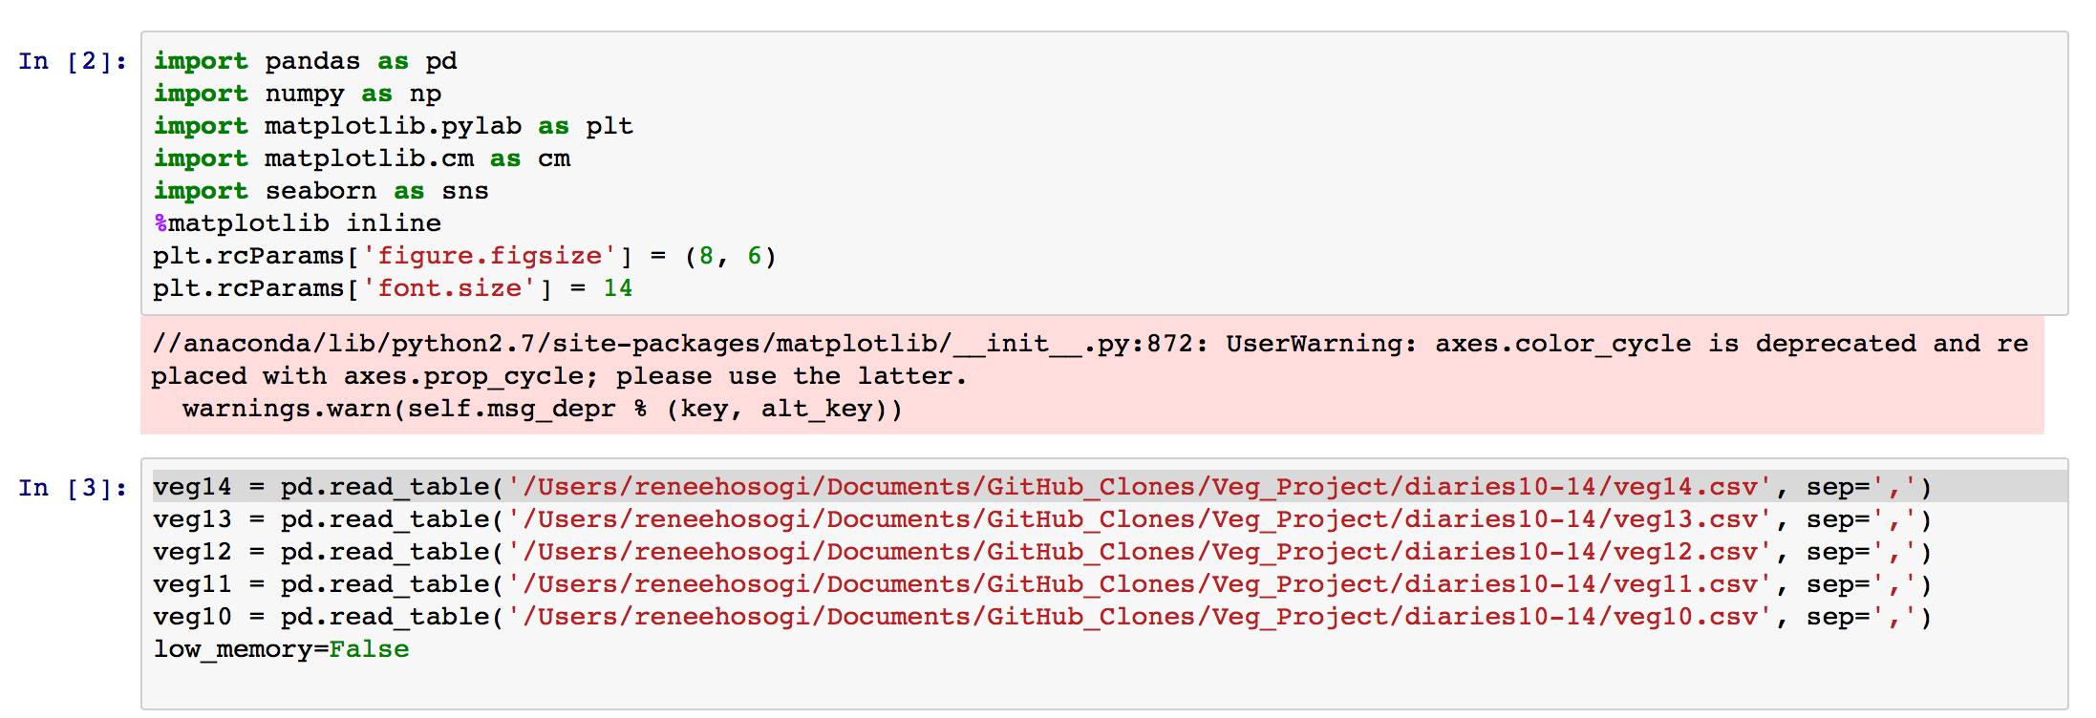
Read in the data…
Add new columns…
MEAT’= ‘BEEF’, ‘POULTRY’, ‘PORK’, ‘SEAFOOD’, ‘OTHMEAT’
‘PRODUCE’-‘FRSHFRUIT’, ‘FRSHVEG’, ‘PROCFRUT’, ‘PROCVEG’

Slide 12
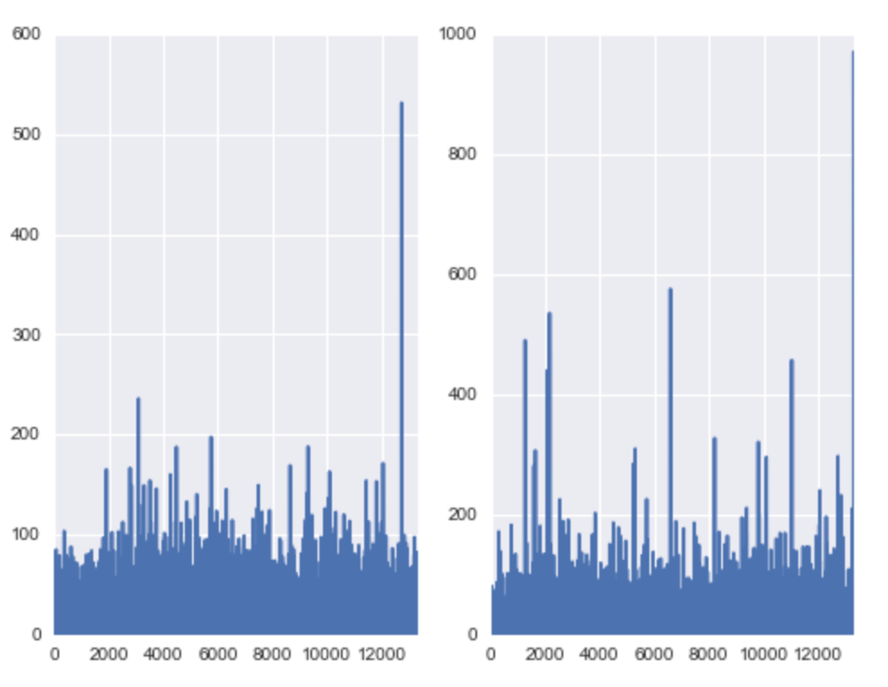
2014 Meat and Produce consumption by Family Size

Slide 13
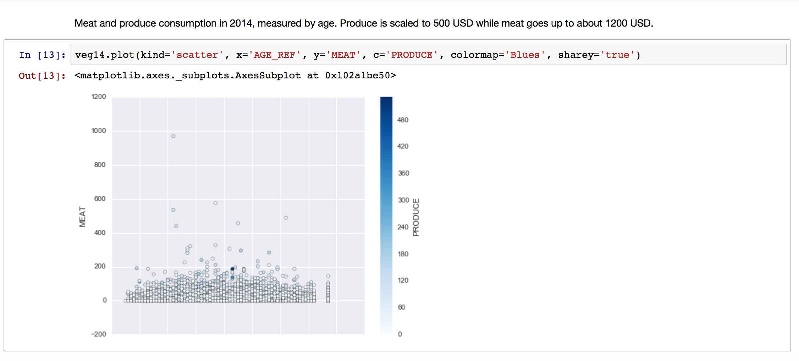
2014 Meat and Produce consumption by Age

Slide 14
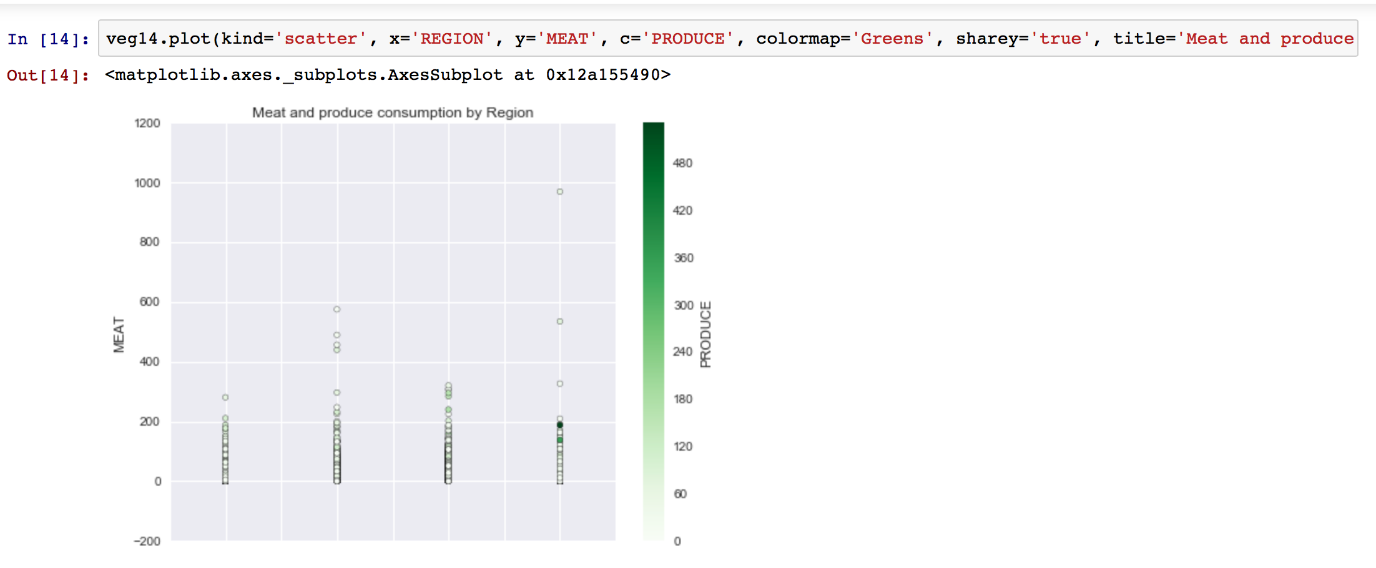
2014 Meat and Produce consumption by Region

Slide 15
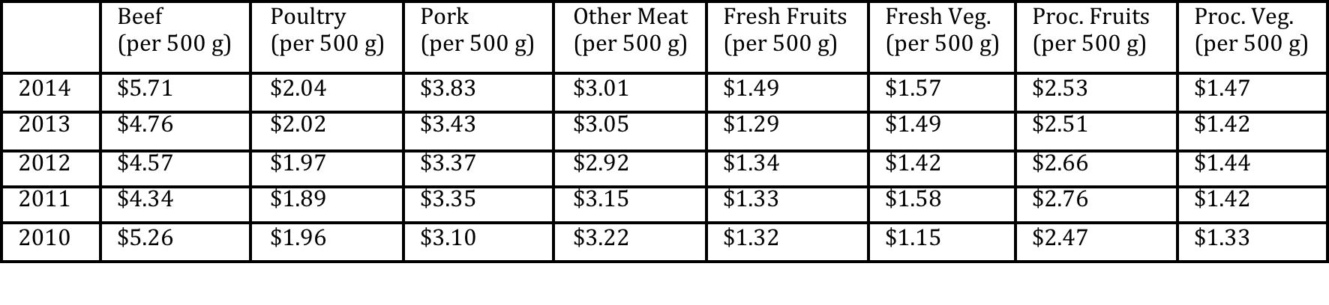
Initial adjustments
Meat costs more to produce than produce
US Department of Labor’s annual price reports to even playing field

Slide 16
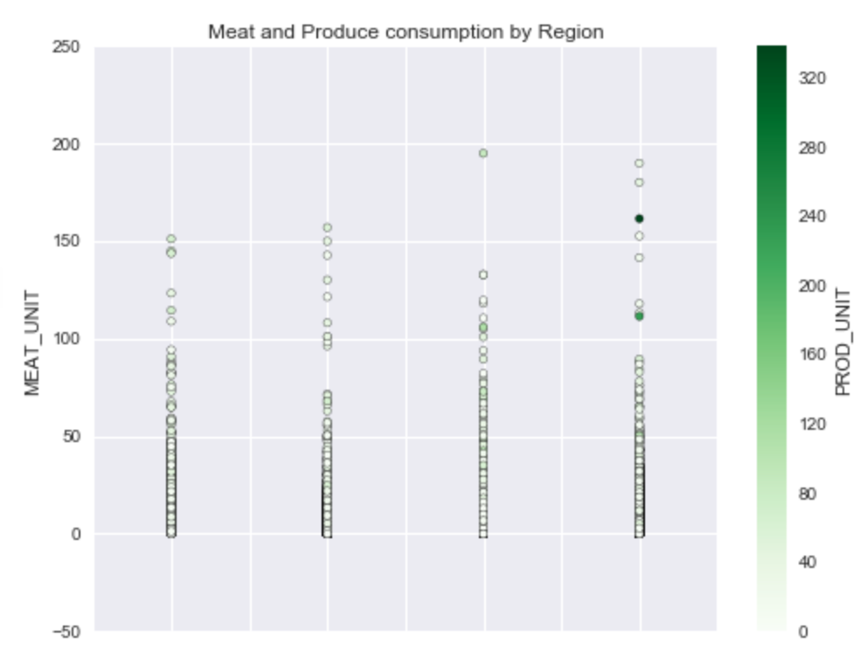
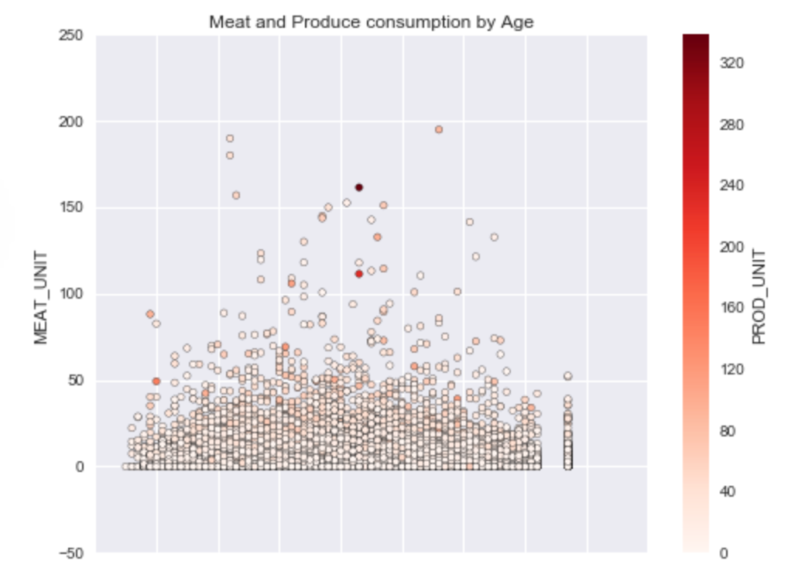
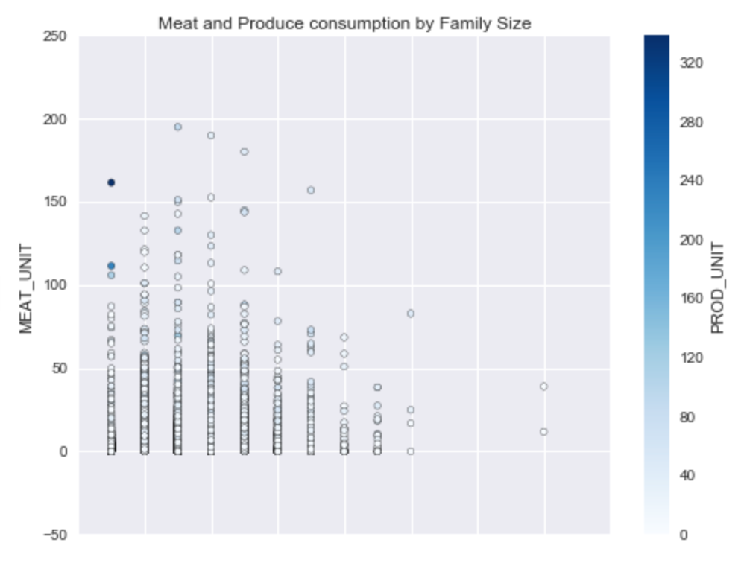

Slide 17
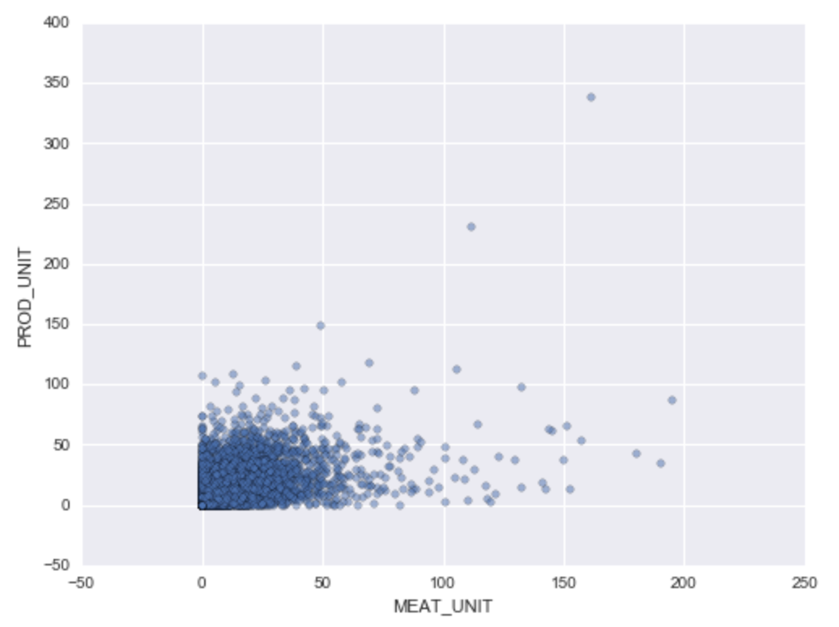

Slide 18
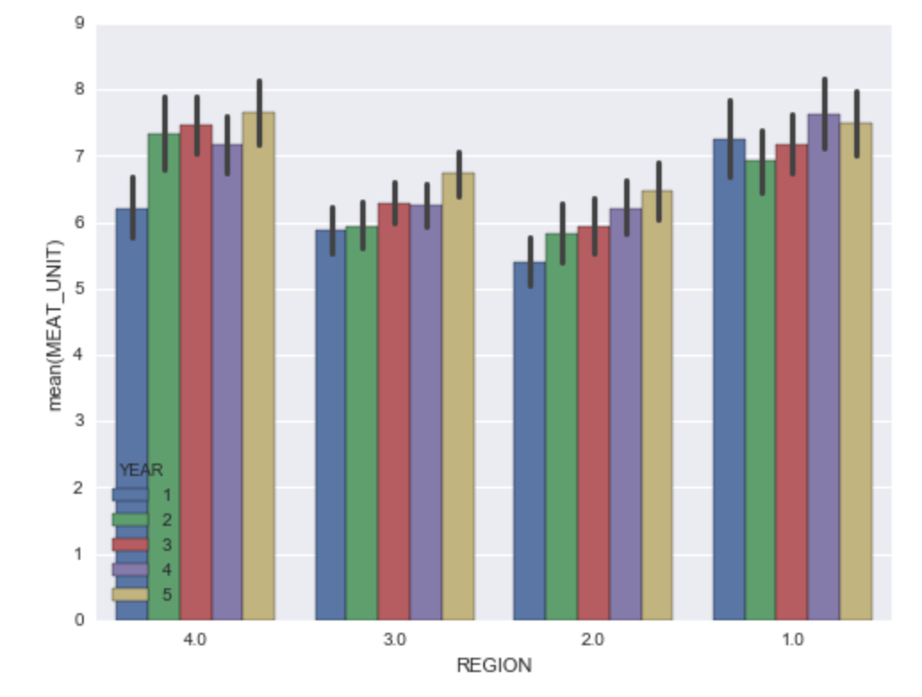
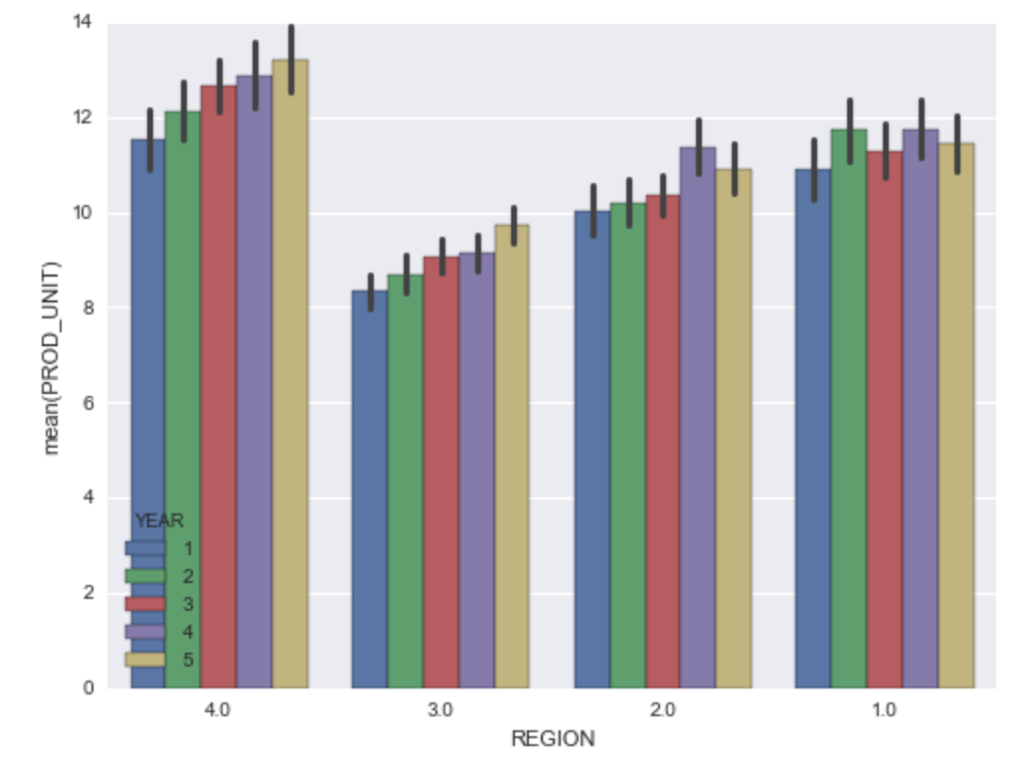
Meat and Produce by Region from 2010-2014

Slide 19
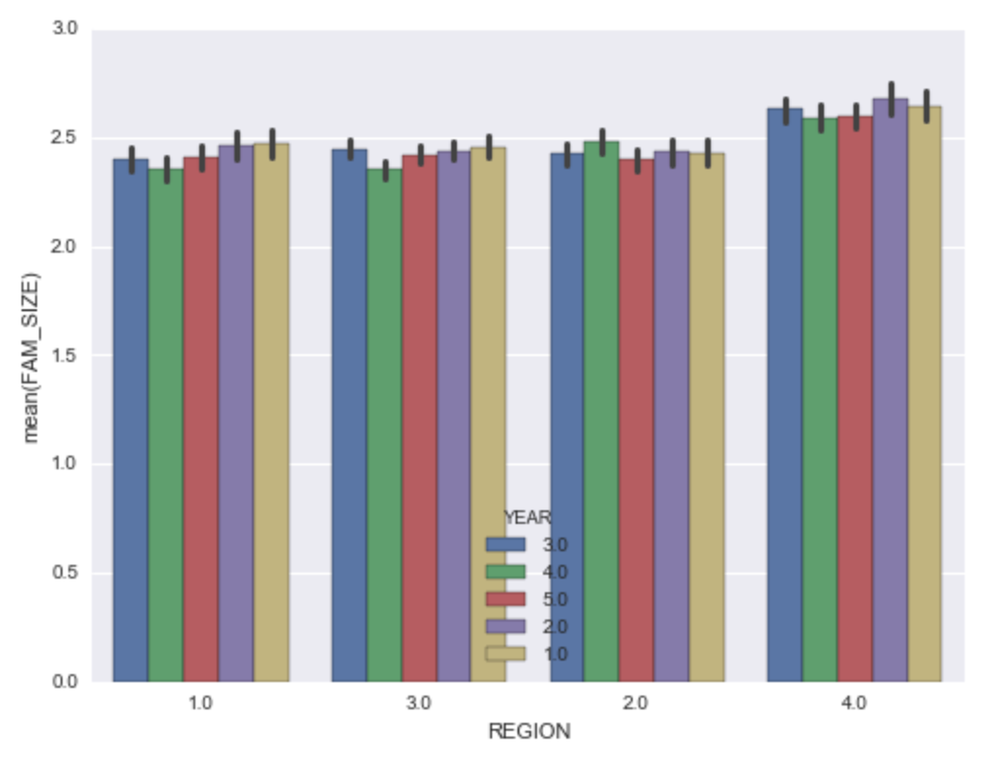
Average family size by region from 2010-2014

Slide 20
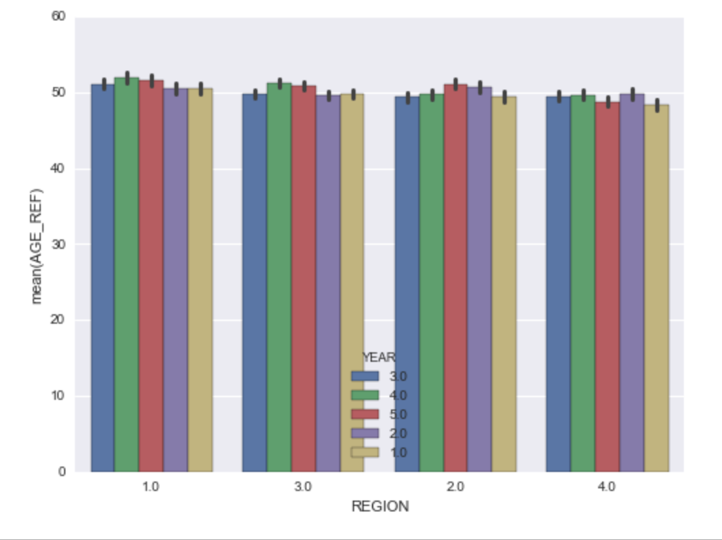
Average age of participants by region 2010-2014

Slide 21
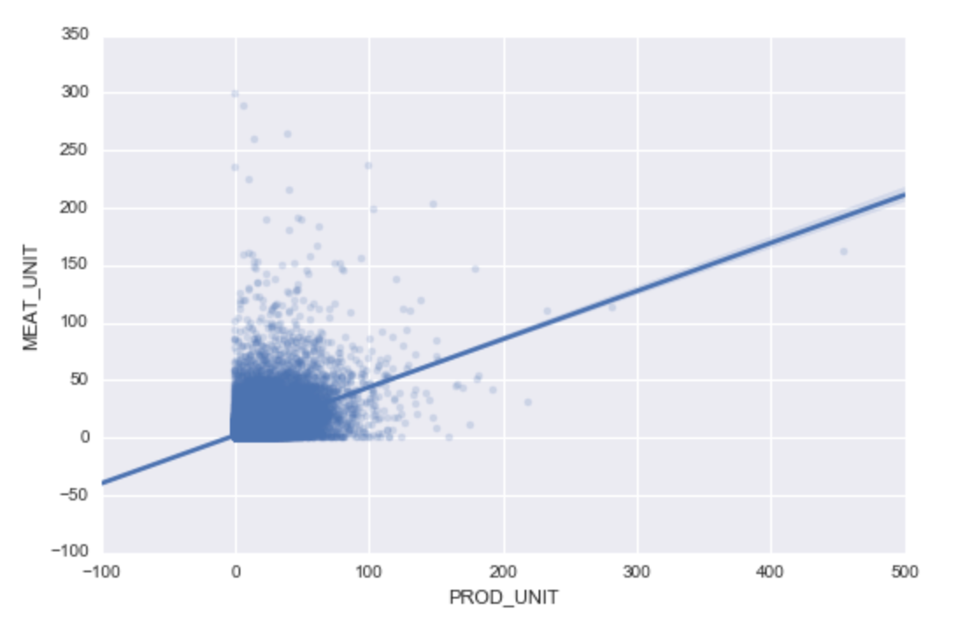
Modeling this data

Slide 22
Conclusion
Meat and produce are being bought in nearly equal amounts
Linear trends in purchasing more food is likely not a long term model
There has to be some sort of plateau when it comes to resources
More data from previous years likely would have contributed to linear trend
Consumption data in conjunction with natural resources data might make for an interesting follow-up

Slide 23
Sources
https://www.un.org/development/desa/en/news/population/un-report-world-population-projected-to-reach-9-6-billion-by-2050.html
https://news.aetna.com/news-releases/who-is-the-healthiest-new-aetna-study-shows-that-millennials-genxers-and-baby-boomers-all-think-they-are-the-healthiest-generation/
http://www.gallup.com/poll/2992/americans-environmentally-friendly-issue-seen-urgent-problem.aspx
http://water.usgs.gov/edu/activity-watercontent.php
http://www.who.int/features/qa/cancer-red-meat/en/

